Slide 1
Configuring CNN Accelerator
AIHA Intern 2023 NPU
Dongbeom Son
Hanyang University
bumin35@hanyang.ac.kr
2023.09.28

Slide 2
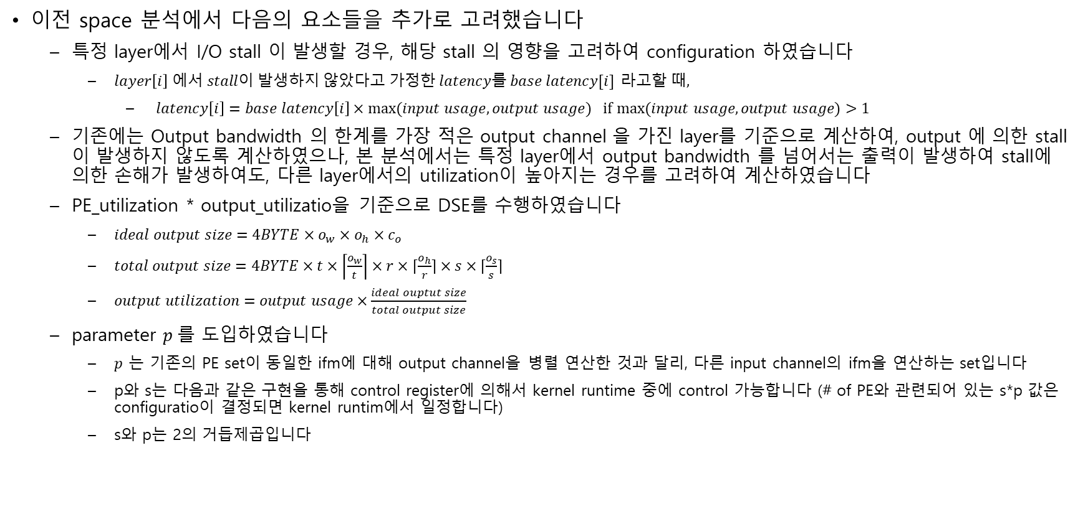
Considerations for DSE(Design Space Exploration)
이전 space 분석에서 다음의 요소들을 추가로 고려했습니다
  특정 layer에서 I/O stall 이 발생할 경우, 해당 stall 의 영향을 고려하여 configuration 하였습니다
    $layer\left[i\right] 에서 stall이 발생하지 않았다고 가정한 latency를 base latency[i]$ 라$고할 때,$
      $latency\left[i\right]=base latency\left[i\right]×max⁡(input usage, output usage) if$ $\max{(input usage, output usage)}>1$
  기존에는 Output bandwidth 의 한계를 가장 적은 output channel 을 가진 layer를 기준으로 계산하여, output 에 의한 stall 이 발생하지 않도록 계산하였으나, 본 분석에서는 특정 layer에서 output bandwidth 를 넘어서는 출력이 발생하여 stall에 의한 손해가 발생하여도, 다른 layer에서의 utilization이 높아지는 경우를 고려하여 계산하였습니다
  PE_utilization * output_utilizatio을 기준으로 DSE를 수행하였습니다
    $ideal output size=4BYTE×o_{w}×o_{h}×c_{o}$
    $total output size=4BYTE×t×\left\lceil \frac{o_{w}}{t}\right\rceil ×r×⌈\frac{o_{h}}{r}⌉×s×⌈\frac{o_{s}}{s}⌉$
    $output utilization=output usage×\frac{ideal ouptut size}{total output size}$
  parameter $p$를 도입하였습니다
    $p$ 는 기존의 PE set이 동일한 ifm에 대해 output channel을 병렬 연산한 것과 달리, 다른 input channel의 ifm을 연산하는 set입니다
    p와 s는 다음과 같은 구현을 통해 control register에 의해서 kernel runtime 중에 control 가능합니다 (# of PE와 관련되어 있는 s*p 값은 configuratio이 결정되면 kernel runtim에서 일정합니다)
    s와 p는 2의 거듭제곱입니다

Slide 3
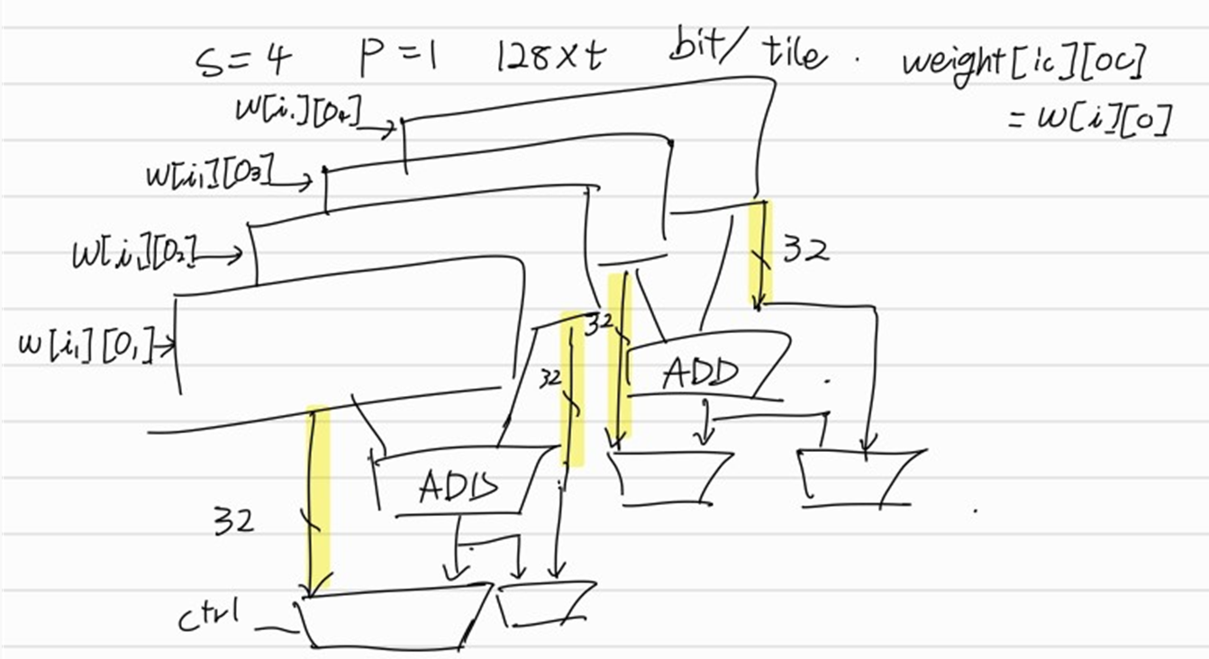
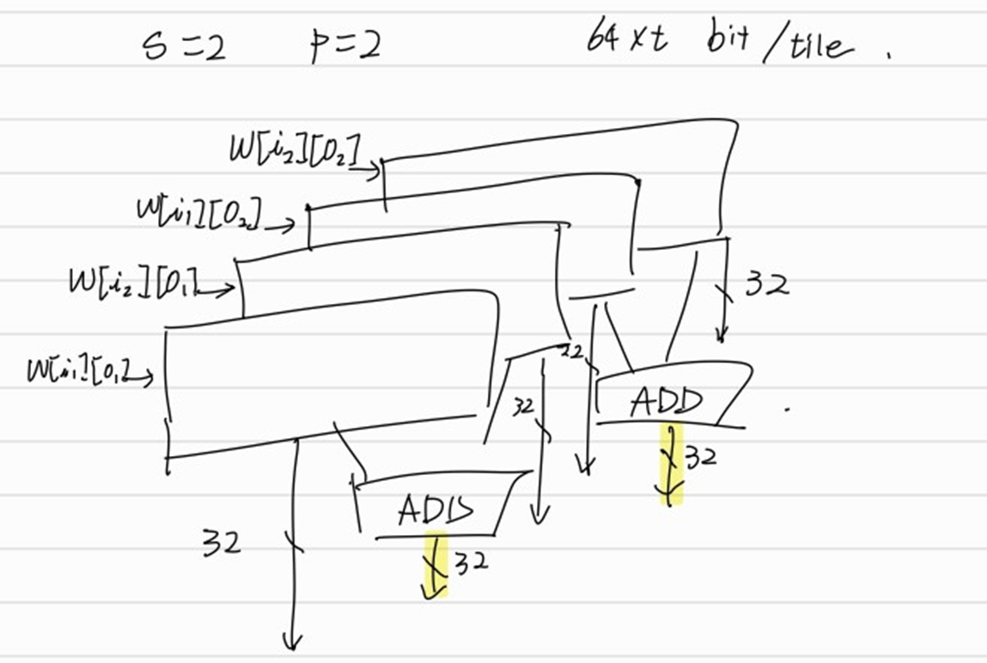

$s×p=\left[s, p\right]$ configuration
p (input channel parallelize) 값이 증가하면 다음과 같은 특징이 있습니다
  PE_set (s) 만을 증가시켰을 때는 s보다 큰 ci에 대해 overhead가 발생하여 PE_set을 증가시키는 효율이 감소하였습니다
    s > ci가 될 경우 대신 p를 증가시켜 ci에 대한 overhead을 줄이며 # PE를 증가시킬 수 있습니다
      # PE = $k×r×s×p$
  s x p가 일정할 때, p의 증가는 input IF(interface) usage의 비중을 높입니다
    $input IF usage=\left(IFM IF usage+WGT IF usage\right)=IF_CLK×\left[\left(r+2\right)×p+s×p×\frac{k^{2}}{t+overhead}\right]$
    $output IF usage=IF_CLK×\frac{4×t×r×s}{\left(t+overhead\right)×\left\lceil \frac{c_{i}\left[i\right]}{p}\right\rceil }$
memory

Slide 4
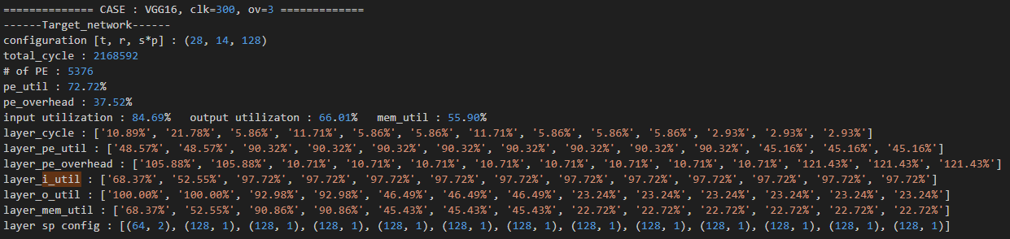
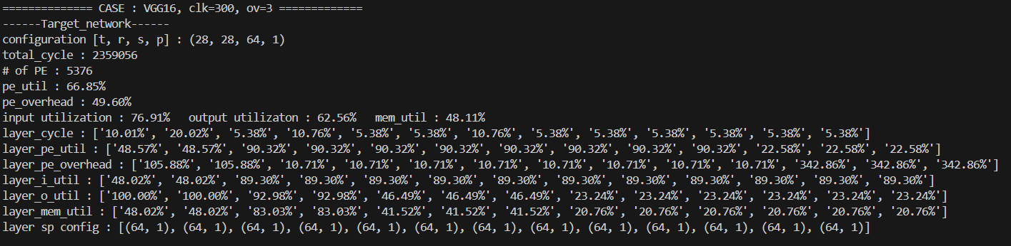
Input channel parallelization Efficiency

Slide 5
Configuration Table / 300Mhz
Config Target Network | VGG16
Clock | 300MHz
Architecture overhead | 3
Network | VGG16
Configuration [t, r, s*p] | (28, 14, 128)
Latency [cycles] | 2168592
# of PE | 5376
PE utilization | 72.72%
Overhead | 37.52%
Memory usage | 55.90%
- Input usage | 84.69%
- Output usage | 66.01%
- Output utilization | 64.99%
Config Target Network | VGG16
Clock | 300MHz
Architecture overhead | 3
Network | Resnet50
Configuration [t, r, s*p] | (28, 14, 128)
Latency [cycles] | 361713
# of PE | 5376
PE utilization | 31.71%
Overhead | 215.39%
Memory usage | 42.24%
- Input usage | 94.13%
- Output usage | 44.88%
- Output utilization | 28.05%
Config Target Network | Resnet50
Clock | 300MHz
Architecture overhead | 3
Network | VGG16
Configuration [t, r, s*p] | (14, 14, 64)
Latency [cycles] | 3829760
# of PE | 2688
PE utilization | 82.35%
Overhead | 21.43%
Memory usage | 33.74%
- Input usage | 91.70%
- Output usage | 36.80%
- Output utilization | 36.80%
Config Target Network | Resnet50
Clock | 300MHz
Architecture overhead | 3
Network | Resnet50
Configuration [t, r, s*p] | (14, 14, 64)
Latency [cycles] | 435200
# of PE | 2688
PE utilization | 52.71%
Overhead | 89.73%
Memory usage | 24.88%
- Input usage | 91.70%
- Output usage | 27.13%
- Output utilization | 23.31%
Config Target Network | VGG16
Clock | 300MHz
Architecture overhead | 0
Network | VGG16
Configuration [t, r, s*p] | (28, 14, 128)
Latency [cycles] | 2093786
# of PE | 5376
PE utilization | 75.32%
Overhead | 32.77%
Memory usage | 58.14%
- Input usage | 85.04%
- Output usage | 68.37%
- Output utilization | 67.31%
Config Target Network | VGG16
Clock | 300MHz
Architecture overhead | 0
Network | Resnet50
Configuration [t, r, s*p] | (28, 14, 128)
Latency [cycles] | 345450
# of PE | 5376
PE utilization | 33.20%
Overhead | 201.21%
Memory usage | 44.90%
- Input usage | 95.55%
- Output usage | 46.99%
- Output utilization | 29.37%
Config Target Network | Resnet50
Clock | 300MHz
Architecture overhead | 0
Network | VGG16
Configuration [t, r, s*p] | (14, 14, 64)
Latency [cycles] | 3312951
# of PE | 2688
PE utilization | 95.20%
Overhead | 5.04%
Memory usage | 42.54%
- Input usage | 100.00%
- Output usage | 42.54%
- Output utilization | 42.54%
Config Target Network | Resnet50
Clock | 300MHz
Architecture overhead | 0
Network | Resnet50
Configuration [t, r, s*p] | (14, 14, 64)
Latency [cycles] | 376472
# of PE | 2688
PE utilization | 60.93%
Overhead | 64.13%
Memory usage | 31.36%
- Input usage | 100.00%
- Output usage | 31.36%
- Output utilization | 26.95%

Slide 6
Configuration Table
Config Target Network | VGG16
Clock | 300MHz
Architecture overhead | 3
Network | VGG16
Configuration [t, r, s*p] | (28, 14, 128)
Latency [cycles] | 2168592
# of PE | 5376
PE utilization | 72.72%
Overhead | 37.52%
Memory usage | 55.90%
- Input usage | 84.69%
- Output usage | 66.01%
- Output utilization | 64.99%
Layer Ananlisys
Computational ratio | ['10.89%', '21.78%', '5.86%', '11.71%', '5.86%', '5.86%', '11.71%', '5.86%', '5.86%', '5.86%', '2.93%', '2.93%', '2.93%']
PE utilization | ['48.57%', '48.57%', '90.32%', '90.32%', '90.32%', '90.32%', '90.32%', '90.32%', '90.32%', '90.32%', '45.16%', '45.16%', '45.16%']
Overhead | ['105.88%', '105.88%', '10.71%', '10.71%', '10.71%', '10.71%', '10.71%', '10.71%', '10.71%', '10.71%', '121.43%', '121.43%', '121.43%']
Memory usage | ['68.37%', '52.55%', '90.86%', '90.86%', '45.43%', '45.43%', '45.43%', '22.72%', '22.72%', '22.72%', '22.72%', '22.72%', '22.72%']
- Input usage | ['68.37%', '52.55%', '97.72%', '97.72%', '97.72%', '97.72%', '97.72%', '97.72%', '97.72%', '97.72%', '97.72%', '97.72%', '97.72%']
- Output usage | ['100.00%', '100.00%', '92.98%', '92.98%', '46.49%', '46.49%', '46.49%', '23.24%', '23.24%', '23.24%', '23.24%', '23.24%', '23.24%']
- Output utilization | ['100.00%', '100.00%', '92.98%', '92.98%', '46.49%', '46.49%', '46.49%', '23.24%', '23.24%', '23.24%', '11.62%', '11.62%', '11.62%']
[s, p] config | [(64, 2), (128, 1), (128, 1), (128, 1), (128, 1), (128, 1), (128, 1), (128, 1), (128, 1), (128, 1), (128, 1), (128, 1), (128, 1)]

Slide 7
Configuration Table
Config Target Network | VGG16
Clock | 300MHz
Architecture overhead | 3
Network | Resnet50
Configuration [t, r, s*p] | (28, 14, 128)
Latency [cycles] | 361713
# of PE | 5376
PE utilization | 31.71%
Overhead | 215.39%
Memory usage | 42.24%
- Input usage | 94.13%
- Output usage | 44.88%
- Output utilization | 28.05%
Layer Ananlisys
Computational ratio | ['12.24%', '8.78%', '26.33%', '52.66%']
PE utilization | ['48.57%', '90.32%', '45.16%', '11.29%']
Overhead | ['105.88%', '10.71%', '121.43%', '785.71%']
Memory usage | ['68.37%', '90.86%', '45.43%', '22.72%']
- Input usage | ['68.37%', '97.72%', '97.72%', '97.72%']
- Output usage | ['100.00%', '92.98%', '46.49%', '23.24%']
- Output utilization | ['100.00%', '92.98%', '23.24%', '2.91%']
[s, p] config | [(64, 2), (128, 1), (128, 1), (128, 1)]

Slide 8
Configuration Table
Config Target Network | Resnet50
Clock | 300MHz
Architecture overhead | 3
Network | VGG16
Configuration [t, r, s*p] | (14, 14, 64)
Latency [cycles] | 3829760
# of PE | 2688
PE utilization | 82.35%
Overhead | 21.43%
Memory usage | 33.74%
- Input usage | 91.70%
- Output usage | 36.80%
- Output utilization | 36.80%
Layer Ananlisys
Computational ratio | ['7.27%', '14.55%', '7.27%', '14.55%', '7.27%', '7.27%', '14.55%', '7.27%', '7.27%', '7.27%', '1.82%', '1.82%', '1.82%']
PE utilization | ['82.35%', '82.35%', '82.35%', '82.35%', '82.35%', '82.35%', '82.35%', '82.35%', '82.35%', '82.35%', '82.35%', '82.35%', '82.35%']
Overhead | ['21.43%', '21.43%', '21.43%', '21.43%', '21.43%', '21.43%', '21.43%', '21.43%', '21.43%', '21.43%', '21.43%', '21.43%', '21.43%']
Memory usage | ['77.73%', '77.73%', '38.87%', '38.87%', '19.43%', '19.43%', '19.43%', '9.72%', '9.72%', '9.72%', '9.72%', '9.72%', '9.72%']
- Input usage | ['91.70%', '91.70%', '91.70%', '91.70%', '91.70%', '91.70%', '91.70%', '91.70%', '91.70%', '91.70%', '91.70%', '91.70%', '91.70%']
- Output usage | ['84.78%', '84.78%', '42.39%', '42.39%', '21.19%', '21.19%', '21.19%', '10.60%', '10.60%', '10.60%', '10.60%', '10.60%', '10.60%']
- Output utilization | ['84.78%', '84.78%', '42.39%', '42.39%', '21.19%', '21.19%', '21.19%', '10.60%', '10.60%', '10.60%', '10.60%', '10.60%', '10.60%']
[s, p] config | [(64, 1), (64, 1), (64, 1), (64, 1), (64, 1), (64, 1), (64, 1), (64, 1), (64, 1), (64, 1), (64, 1), (64, 1), (64, 1)]

Slide 9
Configuration Table
Config Target Network | Resnet50
Clock | 300MHz
Architecture overhead | 3
Network | Resnet50
Configuration [t, r, s*p] | (14, 14, 64)
Latency [cycles] | 435200
# of PE | 2688
PE utilization | 52.71%
Overhead | 89.73%
Memory usage | 24.88%
- Input usage | 91.70%
- Output usage | 27.13%
- Output utilization | 23.31%
Layer Ananlisys
Computational ratio | ['12.00%', '16.00%', '24.00%', '48.00%']
PE utilization | ['82.35%', '82.35%', '82.35%', '20.59%']
Overhead | ['21.43%', '21.43%', '21.43%', '385.71%']
Memory usage | ['77.73%', '38.87%', '19.43%', '9.72%']
- Input usage | ['91.70%', '91.70%', '91.70%', '91.70%']
- Output usage | ['84.78%', '42.39%', '21.19%', '10.60%']
- Output utilization | ['84.78%', '42.39%', '21.19%', '2.65%']
[s, p] config | [(64, 1), (64, 1), (64, 1), (64, 1)]

Slide 10
Configuration Table
Config Target Network | VGG16
Clock | 300MHz
Architecture overhead | 0
Network | VGG16
Configuration [t, r, s*p] | (28, 14, 128)
Latency [cycles] | 2093786
# of PE | 5376
PE utilization | 75.32%
Overhead | 32.77%
Memory usage | 58.14%
- Input usage | 85.04%
- Output usage | 68.37%
- Output utilization | 67.31%
Layer Ananlisys
Computational ratio | ['11.28%', '22.55%', '5.75%', '11.51%', '5.75%', '5.75%', '11.51%', '5.75%', '5.75%', '5.75%', '2.88%', '2.88%', '2.88%']
PE utilization | ['48.57%', '48.57%', '95.20%', '95.20%', '95.20%', '95.20%', '95.20%', '95.20%', '95.20%', '95.20%', '47.60%', '47.60%', '47.60%']
Overhead | ['105.88%', '105.88%', '5.04%', '5.04%', '5.04%', '5.04%', '5.04%', '5.04%', '5.04%', '5.04%', '110.09%', '110.09%', '110.09%']
Memory usage | ['65.31%', '51.02%', '98.00%', '98.00%', '49.00%', '49.00%', '49.00%', '24.50%', '24.50%', '24.50%', '24.50%', '24.50%', '24.50%']
- Input usage | ['65.31%', '51.02%', '100.00%', '100.00%', '100.00%', '100.00%', '100.00%', '100.00%', '100.00%', '100.00%', '100.00%', '100.00%', '100.00%']
- Output usage | ['100.00%', '100.00%', '98.00%', '98.00%', '49.00%', '49.00%', '49.00%', '24.50%', '24.50%', '24.50%', '24.50%', '24.50%', '24.50%']
- Output utilization | ['100.00%', '100.00%', '98.00%', '98.00%', '49.00%', '49.00%', '49.00%', '24.50%', '24.50%', '24.50%', '12.25%', '12.25%', '12.25%']
[s, p] config | [(64, 2), (128, 1), (128, 1), (128, 1), (128, 1), (128, 1), (128, 1), (128, 1), (128, 1), (128, 1), (128, 1), (128, 1), (128, 1)]

Slide 11
Configuration Table
Config Target Network | VGG16
Clock | 300MHz
Architecture overhead | 0
Network | Resnet50
Configuration [t, r, s*p] | (28, 14, 128)
Latency [cycles] | 345450
# of PE | 5376
PE utilization | 33.20%
Overhead | 201.21%
Memory usage | 44.90%
- Input usage | 95.55%
- Output usage | 46.99%
- Output utilization | 29.37%
Layer Ananlisys
Computational ratio | ['12.82%', '8.72%', '26.16%', '52.31%']
PE utilization | ['48.57%', '95.20%', '47.60%', '11.90%']
Overhead | ['105.88%', '5.04%', '110.08%', '740.34%']
Memory usage | ['65.31%', '98.00%', '49.00%', '24.50%']
- Input usage | ['65.31%', '100.00%', '100.00%', '100.00%']
- Output usage | ['100.00%', '98.00%', '49.00%', '24.50%']
- Output utilization | ['100.00%', '98.00%', '24.50%', '3.06%']
[s, p] config | [(64, 2), (128, 1), (128, 1), (128, 1)]

Slide 12
Configuration Table
Config Target Network | Resnet50
Clock | 300MHz
Architecture overhead | 0
Network | VGG16
Configuration [t, r, s*p] | (14, 14, 64)
Latency [cycles] | 3312951
# of PE | 2688
PE utilization | 95.20%
Overhead | 5.04%
Memory usage | 42.54%
- Input usage | 100.00%
- Output usage | 42.54%
- Output utilization | 42.54%
Layer Ananlisys
Computational ratio | ['7.27%', '14.55%', '7.27%', '14.55%', '7.27%', '7.27%', '14.55%', '7.27%', '7.27%', '7.27%', '1.82%', '1.82%', '1.82%']
PE utilization | ['95.20%', '95.20%', '95.20%', '95.20%', '95.20%', '95.20%', '95.20%', '95.20%', '95.20%', '95.20%', '95.20%', '95.20%', '95.20%']
Overhead | ['5.04%', '5.04%', '5.04%', '5.04%', '5.04%', '5.04%', '5.04%', '5.04%', '5.04%', '5.04%', '5.04%', '5.04%', '5.04%']
Memory usage | ['98.00%', '98.00%', '49.00%', '49.00%', '24.50%', '24.50%', '24.50%', '12.25%', '12.25%', '12.25%', '12.25%', '12.25%', '12.25%']
- Input usage | ['100.00%', '100.00%', '100.00%', '100.00%', '100.00%', '100.00%', '100.00%', '100.00%', '100.00%', '100.00%', '100.00%', '100.00%', '100.00%']
- Output usage | ['98.00%', '98.00%', '49.00%', '49.00%', '24.50%', '24.50%', '24.50%', '12.25%', '12.25%', '12.25%', '12.25%', '12.25%', '12.25%']
- Output utilization | ['98.00%', '98.00%', '49.00%', '49.00%', '24.50%', '24.50%', '24.50%', '12.25%', '12.25%', '12.25%', '12.25%', '12.25%', '12.25%']
[s, p] config | [(64, 1), (64, 1), (64, 1), (64, 1), (64, 1), (64, 1), (64, 1), (64, 1), (64, 1), (64, 1), (64, 1), (64, 1), (64, 1)]

Slide 13
Configuration Table
Config Target Network | Resnet50
Clock | 300MHz
Architecture overhead | 0
Network | Resnet50
Configuration [t, r, s*p] | (14, 14, 64)
Latency [cycles] | 376472
# of PE | 2688
PE utilization | 60.93%
Overhead | 64.13%
Memory usage | 31.36%
- Input usage | 100.00%
- Output usage | 31.36%
- Output utilization | 26.95%
Layer Ananlisys
Computational ratio | ['12.00%', '16.00%', '24.00%', '48.00%']
PE utilization | ['95.20%', '95.20%', '95.20%', '23.80%']
Overhead | ['5.04%', '5.04%', '5.04%', '320.17%']
Memory usage | ['98.00%', '49.00%', '24.50%', '12.25%']
- Input usage | ['100.00%', '100.00%', '100.00%', '100.00%']
- Output usage | ['98.00%', '49.00%', '24.50%', '12.25%']
- Output utilization | ['98.00%', '49.00%', '24.50%', '3.06%']
[s, p] config | [(64, 1), (64, 1), (64, 1), (64, 1)]

Slide 14
Configuration Table / 500Mhz
Config Target Network | VGG16
Clock | 500MHz
Architecture overhead | 3
Network | VGG16
Configuration [t, r, s*p] | (28, 14, 64)
Latency [cycles] | 4274701
# of PE | 2688
PE utilization | 73.78%
Overhead | 35.54%
Memory usage | 50.94%
- Input usage | 91.26%
- Output usage | 55.81%
- Output utilization | 54.95%
Config Target Network | VGG16
Clock | 500MHz
Architecture overhead | 3
Network | Resnet50
Configuration [t, r, s*p] | (28, 14, 64)
Latency [cycles] | 746418
# of PE | 2688
PE utilization | 30.73%
Overhead | 225.41%
Memory usage | 35.11%
- Input usage | 96.87%
- Output usage | 36.25%
- Output utilization | 22.65%
Config Target Network | Resnet50
Clock | 500MHz
Architecture overhead | 3
Network | VGG16
Configuration [t, r, s*p] | (14, 7, 64)
Latency [cycles] | 10063062
# of PE | 1344
PE utilization | 62.68%
Overhead | 59.53%
Memory usage | 23.34%
- Input usage | 100.00%
- Output usage | 23.34%
- Output utilization | 23.34%
Config Target Network | Resnet50
Clock | 500MHz
Architecture overhead | 3
Network | Resnet50
Configuration [t, r, s*p] | (14, 7, 64)
Latency [cycles] | 869085
# of PE | 1344
PE utilization | 52.79%
Overhead | 89.45%
Memory usage | 20.52%
- Input usage | 100.00%
- Output usage | 20.52%
- Output utilization | 19.46%
Config Target Network | VGG16
Clock | 500MHz
Architecture overhead | 0
Network | VGG16
Configuration [t, r, s*p] | (28, 14, 64)
Latency [cycles] | 4136159
# of PE | 2688
PE utilization | 76.25%
Overhead | 31.14%
Memory usage | 51.97%
- Input usage | 90.10%
- Output usage | 57.68%
- Output utilization | 56.79%
Config Target Network | VGG16
Clock | 500MHz
Architecture overhead | 0
Network | Resnet50
Configuration [t, r, s*p] | (28, 14, 64)
Latency [cycles] | 716299
# of PE | 2688
PE utilization | 32.02%
Overhead | 212.28%
Memory usage | 36.42%
- Input usage | 96.43%
- Output usage | 37.77%
- Output utilization | 23.61%
Config Target Network | Resnet50
Clock | 500MHz
Architecture overhead | 0
Network | VGG16
Configuration [t, r, s*p] | (14, 7, 32)
Latency [cycles] | 12615680
# of PE | 672
PE utilization | 100.00%
Overhead | 0.00%
Memory usage | 16.87%
- Input usage | 90.60%
- Output usage | 18.62%
- Output utilization | 18.62%
Config Target Network | Resnet50
Clock | 500MHz
Architecture overhead | 0
Network | Resnet50
Configuration [t, r, s*p] | (14, 7, 32)
Latency [cycles] | 1089536
# of PE | 672
PE utilization | 84.21%
Overhead | 18.75%
Memory usage | 14.83%
- Input usage | 90.60%
- Output usage | 16.37%
- Output utilization | 15.52%

Slide 15
Configuration Table
Config Target Network | VGG16
Clock | 500MHz
Architecture overhead | 3
Network | VGG16
Configuration [t, r, s*p] | (28, 14, 64)
Latency [cycles] | 4274701
# of PE | 2688
PE utilization | 73.78%
Overhead | 35.54%
Memory usage | 50.94%
- Input usage | 91.26%
- Output usage | 55.81%
- Output utilization | 54.95%
Layer Ananlisys
Computational ratio | ['9.21%', '18.41%', '6.29%', '12.59%', '6.29%', '6.29%', '12.59%', '6.29%', '6.29%', '6.29%', '3.15%', '3.15%', '3.15%']
PE utilization | ['58.29%', '58.29%', '85.25%', '85.25%', '85.25%', '85.25%', '85.25%', '85.25%', '85.25%', '85.25%', '42.63%', '42.63%', '42.63%']
Overhead | ['71.57%', '71.57%', '17.30%', '17.30%', '17.30%', '17.30%', '17.30%', '17.30%', '17.30%', '17.30%', '134.59%', '134.59%', '134.59%']
Memory usage | ['68.37%', '68.37%', '73.13%', '73.13%', '36.57%', '36.57%', '36.57%', '18.28%', '18.28%', '18.28%', '18.28%', '18.28%', '18.28%']
- Input usage | ['68.37%', '68.37%', '100.00%', '100.00%', '100.00%', '100.00%', '100.00%', '100.00%', '100.00%', '100.00%', '100.00%', '100.00%', '100.00%']
- Output usage | ['100.00%', '100.00%', '73.13%', '73.13%', '36.57%', '36.57%', '36.57%', '18.28%', '18.28%', '18.28%', '18.28%', '18.28%', '18.28%']
- Output utilization | ['100.00%', '100.00%', '73.13%', '73.13%', '36.57%', '36.57%', '36.57%', '18.28%', '18.28%', '18.28%', '9.14%', '9.14%', '9.14%']
[s, p] config | [(64, 1), (64, 1), (64, 1), (64, 1), (64, 1), (64, 1), (64, 1), (64, 1), (64, 1), (64, 1), (64, 1), (64, 1), (64, 1)]

Slide 16
Configuration Table
Config Target Network | VGG16
Clock | 500MHz
Architecture overhead | 3
Network | Resnet50
Configuration [t, r, s*p] | (28, 14, 64)
Latency [cycles] | 746418
# of PE | 2688
PE utilization | 30.73%
Overhead | 225.41%
Memory usage | 35.11%
- Input usage | 96.87%
- Output usage | 36.25%
- Output utilization | 22.65%
Layer Ananlisys
Computational ratio | ['9.89%', '9.01%', '27.03%', '54.07%']
PE utilization | ['58.29%', '85.25%', '42.63%', '10.66%']
Overhead | ['71.57%', '17.30%', '134.59%', '838.38%']
Memory usage | ['68.37%', '73.13%', '36.57%', '18.28%']
- Input usage | ['68.37%', '100.00%', '100.00%', '100.00%']
- Output usage | ['100.00%', '73.13%', '36.57%', '18.28%']
- Output utilization | ['100.00%', '73.13%', '18.28%', '2.29%']
[s, p] config | [(64, 1), (64, 1), (64, 1), (64, 1)]

Slide 17
Configuration Table
Config Target Network | Resnet50
Clock | 500MHz
Architecture overhead | 3
Network | VGG16
Configuration [t, r, s*p] | (14, 7, 64)
Latency [cycles] | 10063062
# of PE | 1344
PE utilization | 62.68%
Overhead | 59.53%
Memory usage | 23.34%
- Input usage | 100.00%
- Output usage | 23.34%
- Output utilization | 23.34%
Layer Ananlisys
Computational ratio | ['7.27%', '14.55%', '7.27%', '14.55%', '7.27%', '7.27%', '14.55%', '7.27%', '7.27%', '7.27%', '1.82%', '1.82%', '1.82%']
PE utilization | ['62.68%', '62.68%', '62.68%', '62.68%', '62.68%', '62.68%', '62.68%', '62.68%', '62.68%', '62.68%', '62.68%', '62.68%', '62.68%']
Overhead | ['59.53%', '59.53%', '59.53%', '59.53%', '59.53%', '59.53%', '59.53%', '59.53%', '59.53%', '59.53%', '59.53%', '59.53%', '59.53%']
Memory usage | ['53.77%', '53.77%', '26.89%', '26.89%', '13.44%', '13.44%', '13.44%', '6.72%', '6.72%', '6.72%', '6.72%', '6.72%', '6.72%']
- Input usage | ['100.00%', '100.00%', '100.00%', '100.00%', '100.00%', '100.00%', '100.00%', '100.00%', '100.00%', '100.00%', '100.00%', '100.00%', '100.00%']
- Output usage | ['53.77%', '53.77%', '26.89%', '26.89%', '13.44%', '13.44%', '13.44%', '6.72%', '6.72%', '6.72%', '6.72%', '6.72%', '6.72%']
- Output utilization | ['53.77%', '53.77%', '26.89%', '26.89%', '13.44%', '13.44%', '13.44%', '6.72%', '6.72%', '6.72%', '6.72%', '6.72%', '6.72%']
[s, p] config | [(64, 1), (64, 1), (64, 1), (64, 1), (64, 1), (64, 1), (64, 1), (64, 1), (64, 1), (64, 1), (64, 1), (64, 1), (64, 1)]

Slide 18
Configuration Table
Config Target Network | Resnet50
Clock | 500MHz
Architecture overhead | 3
Network | Resnet50
Configuration [t, r, s*p] | (14, 7, 64)
Latency [cycles] | 869085
# of PE | 1344
PE utilization | 52.79%
Overhead | 89.45%
Memory usage | 20.52%
- Input usage | 100.00%
- Output usage | 20.52%
- Output utilization | 19.46%
Layer Ananlisys
Computational ratio | ['15.79%', '21.05%', '31.58%', '31.58%']
PE utilization | ['62.68%', '62.68%', '62.68%', '31.34%']
Overhead | ['59.53%', '59.53%', '59.53%', '219.07%']
Memory usage | ['53.77%', '26.89%', '13.44%', '6.72%']
- Input usage | ['100.00%', '100.00%', '100.00%', '100.00%']
- Output usage | ['53.77%', '26.89%', '13.44%', '6.72%']
- Output utilization | ['53.77%', '26.89%', '13.44%', '3.36%']
[s, p] config | [(64, 1), (64, 1), (64, 1), (64, 1)]

Slide 19
Configuration Table
Config Target Network | VGG16
Clock | 500MHz
Architecture overhead | 0
Network | VGG16
Configuration [t, r, s*p] | (28, 14, 64)
Latency [cycles] | 4136159
# of PE | 2688
PE utilization | 76.25%
Overhead | 31.14%
Memory usage | 51.97%
- Input usage | 90.10%
- Output usage | 57.68%
- Output utilization | 56.79%
Layer Ananlisys
Computational ratio | ['9.51%', '19.03%', '6.21%', '12.43%', '6.21%', '6.21%', '12.43%', '6.21%', '6.21%', '6.21%', '3.11%', '3.11%', '3.11%']
PE utilization | ['58.29%', '58.29%', '89.25%', '89.25%', '89.25%', '89.25%', '89.25%', '89.25%', '89.25%', '89.25%', '44.62%', '44.62%', '44.62%']
Overhead | ['71.57%', '71.57%', '12.04%', '12.04%', '12.04%', '12.04%', '12.04%', '12.04%', '12.04%', '12.04%', '124.09%', '124.09%', '124.09%']
Memory usage | ['65.31%', '65.31%', '76.56%', '76.56%', '38.28%', '38.28%', '38.28%', '19.14%', '19.14%', '19.14%', '19.14%', '19.14%', '19.14%']
- Input usage | ['65.31%', '65.31%', '100.00%', '100.00%', '100.00%', '100.00%', '100.00%', '100.00%', '100.00%', '100.00%', '100.00%', '100.00%', '100.00%']
- Output usage | ['100.00%', '100.00%', '76.56%', '76.56%', '38.28%', '38.28%', '38.28%', '19.14%', '19.14%', '19.14%', '19.14%', '19.14%', '19.14%']
- Output utilization | ['100.00%', '100.00%', '76.56%', '76.56%', '38.28%', '38.28%', '38.28%', '19.14%', '19.14%', '19.14%', '9.57%', '9.57%', '9.57%']
[s, p] config | [(64, 1), (64, 1), (64, 1), (64, 1), (64, 1), (64, 1), (64, 1), (64, 1), (64, 1), (64, 1), (64, 1), (64, 1), (64, 1)]

Slide 20
Configuration Table
Config Target Network | VGG16
Clock | 500MHz
Architecture overhead | 0
Network | Resnet50
Configuration [t, r, s*p] | (28, 14, 64)
Latency [cycles] | 716299
# of PE | 2688
PE utilization | 32.02%
Overhead | 212.28%
Memory usage | 36.42%
- Input usage | 96.43%
- Output usage | 37.77%
- Output utilization | 23.61%
Layer Ananlisys
Computational ratio | ['10.30%', '8.97%', '26.91%', '53.82%']
PE utilization | ['58.29%', '89.25%', '44.62%', '11.16%']
Overhead | ['71.57%', '12.04%', '124.09%', '796.36%']
Memory usage | ['65.31%', '76.56%', '38.28%', '19.14%']
- Input usage | ['65.31%', '100.00%', '100.00%', '100.00%']
- Output usage | ['100.00%', '76.56%', '38.28%', '19.14%']
- Output utilization | ['100.00%', '76.56%', '19.14%', '2.39%']
[s, p] config | [(64, 1), (64, 1), (64, 1), (64, 1)]

Slide 21
Configuration Table
Config Target Network | Resnet50
Clock | 500MHz
Architecture overhead | 0
Network | VGG16
Configuration [t, r, s*p] | (14, 7, 32)
Latency [cycles] | 12615680
# of PE | 672
PE utilization | 100.00%
Overhead | 0.00%
Memory usage | 16.87%
- Input usage | 90.60%
- Output usage | 18.62%
- Output utilization | 18.62%
Layer Ananlisys
Computational ratio | ['7.27%', '14.55%', '7.27%', '14.55%', '7.27%', '7.27%', '14.55%', '7.27%', '7.27%', '7.27%', '1.82%', '1.82%', '1.82%']
PE utilization | ['100.00%', '100.00%', '100.00%', '100.00%', '100.00%', '100.00%', '100.00%', '100.00%', '100.00%', '100.00%', '100.00%', '100.00%', '100.00%']
Overhead | ['0.00%', '0.00%', '0.00%', '0.00%', '0.00%', '0.00%', '0.00%', '0.00%', '0.00%', '0.00%', '0.00%', '0.00%', '0.00%']
Memory usage | ['38.86%', '38.86%', '19.43%', '19.43%', '9.71%', '9.71%', '9.71%', '4.86%', '4.86%', '4.86%', '4.86%', '4.86%', '4.86%']
- Input usage | ['90.60%', '90.60%', '90.60%', '90.60%', '90.60%', '90.60%', '90.60%', '90.60%', '90.60%', '90.60%', '90.60%', '90.60%', '90.60%']
- Output usage | ['42.89%', '42.89%', '21.45%', '21.45%', '10.72%', '10.72%', '10.72%', '5.36%', '5.36%', '5.36%', '5.36%', '5.36%', '5.36%']
- Output utilization | ['42.89%', '42.89%', '21.45%', '21.45%', '10.72%', '10.72%', '10.72%', '5.36%', '5.36%', '5.36%', '5.36%', '5.36%', '5.36%']
[s, p] config | [(32, 1), (32, 1), (32, 1), (32, 1), (32, 1), (32, 1), (32, 1), (32, 1), (32, 1), (32, 1), (32, 1), (32, 1), (32, 1)]

Slide 22
Configuration Table
Config Target Network | Resnet50
Clock | 500MHz
Architecture overhead | 0
Network | Resnet50
Configuration [t, r, s*p] | (14, 7, 32)
Latency [cycles] | 1089536
# of PE | 672
PE utilization | 84.21%
Overhead | 18.75%
Memory usage | 14.83%
- Input usage | 90.60%
- Output usage | 16.37%
- Output utilization | 15.52%
Layer Ananlisys
Computational ratio | ['15.79%', '21.05%', '31.58%', '31.58%']
PE utilization | ['100.00%', '100.00%', '100.00%', '50.00%']
Overhead | ['0.00%', '0.00%', '0.00%', '100.00%']
Memory usage | ['38.86%', '19.43%', '9.71%', '4.86%']
- Input usage | ['90.60%', '90.60%', '90.60%', '90.60%']
- Output usage | ['42.89%', '21.45%', '10.72%', '5.36%']
- Output utilization | ['42.89%', '21.45%', '10.72%', '2.68%']
[s, p] config | [(32, 1), (32, 1), (32, 1), (32, 1)]

